Slide 1

Lists, Tuples, Sets, Dictionary
Course Name: Python Programming
Course Code: - E1UA311C
Instructor Name: Pooja Vajpayee
Duration: 50 Mins

Slide 2


Review of the key concepts of last session
Python is a high-level, interpreted, and easy-to-learn programming language.
2. Names used for variables, functions, and classes, following specific naming rules.
3. Containers for storing data, dynamically typed without explicit declaration.
4. Performance of loops, break and continue

Slide 3
💡 "How would you save multiple values in a single variable "

Slide 4
At the end of this session students will be able to
Learning Outcome 1 : Apply operations on list.
Learning Outcome 2: Apply operations on tuples.

Slide 5
Session Outline
1. Introduction to Lists.
2 . Opening and Learning Outcomes.
3. Operations on lists.
4. A1 :
5. Tuples in Python.
6 . A2 :
7. Conclusion & Closure

Slide 6
Python Collections (Arrays)
There are four collection data types in the Python programming language:
List is a collection which is ordered and changeable. Allows duplicate members.
Tuple is a collection which is ordered and unchangeable. Allows duplicate members.
Set is a collection which is unordered, unchangeable, and unindexed.
No duplicate members.
Dictionary is a collection which is ordered and changeable.
No duplicate members.

Slide 7

List
Lists are used to store multiple items in a single variable.
Lists are built-in data types in Python used to store collections of data.
Lists are created using square brackets:
thislist=["apple","banana","cherry"]
print(thislist)
A list can contain different data types:
list1 = ["abc", 34, True, 40, "male"]
List items are indexed, the first item has index [0], the second item has index [1] etc.
List items are ordered, changeable, and allow duplicate values.

Slide 8
When we say that lists are ordered, it means that the items have a defined order, and that order will not change.
If you add new items to a list, the new items will be placed at the end of the list.
Note: There are some list methods that will change the order, but in general: the order of the items will not change.
The list is changeable, meaning that we can change, add, and remove items in a list after it has been created.
Since lists are indexed, lists can have items with the same value:
thislist = ["apple", "banana", "cherry", "apple", "cherry"]
print(thislist)

Slide 9
To determine how many items a list has, use the len() function
lists are defined as objects with the data type 'list’:
print(type(list1))
<class 'list’> #output

Slide 10
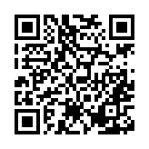
Learning Activity 1

Slide 11

Tuple
Tuples are used to store multiple items in a single variable.
Tuple is built-in data types in Python used to store collections of data.
A tuple is a collection which is ordered and unchangeable.
Tuples are written with round brackets.
thistuple = ("apple", "banana", "cherry")
print(thistuple)
Tuple items are ordered, unchangeable, and allow duplicate values.
Tuple items are indexed, the first item has index [0], the second item has index [1] etc.
When we say that tuples are ordered, it means that the items have a defined order, and that order will not change.

Slide 12
Tuples are unchangeable, meaning that we cannot change, add or remove items after the tuple has been created.
Since tuples are indexed, they can have items with the same value:
thistuple = ("apple", "banana", "cherry", "apple", "cherry")
print(thistuple)
To determine how many items a tuple has, use the len () function .
thistuple = ("apple", "banana", "cherry")
print(len(thistuple))
To create a tuple with only one item, you have to add a comma after the item, otherwise Python will not recognize it as a tuple.

Slide 13
thistuple = ("apple",) print(type(thistuple))
thistuple = ("apple") #NOT a tuple
print(type(thistuple))
A tuple can contain different data types:
tuple1 = ("abc", 34, True, 40, "male")
tuples are defined as objects with the data type 'tuple’:
mytuple = ("apple", "banana", "cherry")
print(type(mytuple))
<class 'tuple’> #output

Slide 14
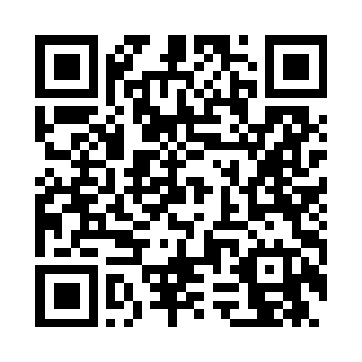
Learning Activity 2

Slide 15
Conclusions-
List is a collection which is ordered and changeable. Allows duplicate members.
Tuple is a collection which is ordered and unchangeable. Allows duplicate members.
Set is a collection which is unordered, unchangeable, and unindexed.
No duplicate members.
Dictionary is a collection which is ordered and changeable.
No duplicate members.

Slide 16
Now Students are able to :
Learning Outcome 1 : Apply operations on list. .
Learning Outcome 2: Apply operations on tuples.

Slide 17

post session activities
* Attempt the Post-session activity on LMS, before next session.

Slide 18
Next session:
Sets, Dictionary

Slide 19

Thank You

